Slide 1
Intro to web challenges

Slide 2
Goals
Understand the basics of web challenges
Enough to learn more individually
List of things to check when starting a challenge
Look at past challenges and understand the basic concepts behind them
We won’t be talking about any automated tools, since those are rarely necessary for Jeopardy style CTFs
But check out Burpsuite, Nessus, and dirbuster!

Slide 3
Why web challenges?
The demand for web applications is growing – lots of jobs out there for security experts!
You can access the from anywhere, and can be run on mobile devices
While greatly improved, native applications are still tied to a particular operating system
Windows, Apple, and Linux all have their own libraries
Instead, you design to meet different browser capabilities (still annoying, but simpler)
Native applications offer more power, but most applications don’t need it
I don’t need a real-time OS to edit my time sheet

Slide 4

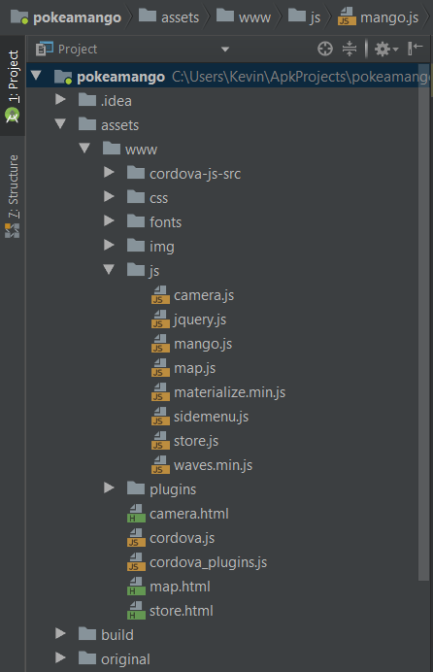
Poke-a-mango – ICECTF 2018
Pokémon GO… but mangoes
While wrapped in an android application, this challenge was secretly a web challenge
The application was really a “browser” that navigated web pages stored in the APK
This is more common than might be expected for applications these days

Slide 5
HTML, CSS, and Javascript in 30 seconds
HTML (Hypertext Markup Language) elements are the basic building blocks for a website. The structure of a website’s design is built with HTML.
Many beginner challenges won’t require more than simply reading the site’s HTML.
CSS (Cascading Style Sheets) allow programmers to define styles to change the look of their HTML
We won’t mention this again. Never seen it used in a challenge, but worth mentioning
Javascript enables dynamic websites. Run locally on a users browser, Javascript brings functionality to otherwise plain pages.
See example.html

Slide 6
HTML Forms
HTML provides the “form” element that is used to collect user input
Input areas can be set by the programmer inside the form element
On submission, the browser will gather the information and send it to the endpoint specified in the form
Web forms should be one of the first things you look at when beginning a web CTF, since they serve as input to the server
No web forms? Don’t overthink it! It’s probably robots.txt…
See form.html and challenge from AISAC

Slide 7
GET and POST
These are the two main HTTP methods you will see
GET, HEAD, POST, PUT, DELETE, CONNECT, OPTIONS, TRACE are all of them
GET is used to retrieve information from a web server. Parameters can be specified by setting them in the URL
https://www.systemacademics.usf.edu/course-inventory/?output=detail&subj=CAP&num=4063
Useful for sharing public data queries like the above
Fancy websites will use the much nicer looking URL Parameters
GET parameters can also be used to send data, but POST should be used instead

Slide 8
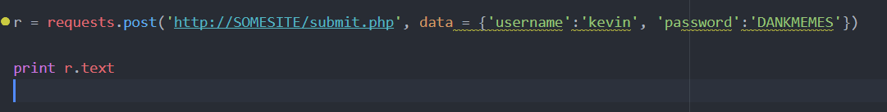
GET and POST
A POST request is used to send data to the server
Your username, password, a new spicy meme for reddit
Data for the server is sent in the body of the request
To send custom POST requests, use tools like curl. Python’s requests library is real simple to use
This tools can allow you to do even more, like changing your user agent

Slide 9
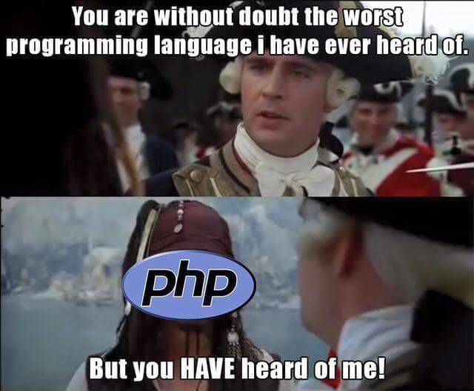
Server-side Scripting
Once we have this user data submitted, we want to do something with it.
To do this, we use programming languages like PHP, JS, or Python.
Web forms, combined with these languages, are what turn simple websites into powerful web applications.
Tougher web challenges will likely require exploiting vulnerabilities at this level.
See form.php and inject.php

Slide 10
Web Frameworks
Web frameworks provide libraries and functions to support web development
It would be tedious to write a database wrapper for every application!
Each framework has its own nuances and vulnerabilities
The best way to learn them is to download and explore them
These are typically harder CTF challenges, since you usually need to know of an exploit for a language/framework, and be familiar enough with the framework to discover it

Slide 11


Shia! – CSAW 2017
UN-SHIA-ED
Challenge based on the Python web framework Django
https://github.com/Ktrio3/ctf_writeups/blob/master/CSAW-2017/web/Shia/solution.md
My write-up. Detailed explanation of each step, but no pictures ☹
Note to self: Take screenshots
https://teamrocketist.github.io/2017/09/17/Web-CSAW-Shia-Labeouf-off/
Thankfully, this team pulled through and took some pictures ☺

Slide 12
Chat – Defcamp 2018
Nodejs challenge that I did not solve ☹
Technically an environment, not a framework, but whatevs
Expressjs, Meteor, and SailsJS are example frameworks built on nodejs
It was solved here though!
https://0xd0ff9.wordpress.com/2018/09/23/defcamp-dctf-2018-chat/
However, it just shows the exploit, and doesn’t explain it. Let’s go over it.

Slide 13
Chat – Defcamp 2018
The prototype stuff can be difficult to understand. This quote clarifies the purpose of __proto__ and makes it much clearer.
http://dmitrysoshnikov.com/ecmascript/javascript-the-core/
“if a property or a method is not found in the object itself (i.e. the object has no such an own property), then there is an attempt to find this property/method in the prototype chain.”

Slide 14
Tips, Tricks and Observations
Not a exhaustive list, but the following slides are a collection of useful tips from me
All of these can be seen put to use in the previous examples
Got a tip? Let me know ☺

Slide 15
1. Robots.txt
Always check it – the one time you don’t will be the one time it’s needed
ICE CTF 2018 had one of these challenges. I didn’t check it… ☹

Slide 16
2. Web Forms
Pay attention to web forms!
Web forms serve as your main form of communication with a web application, and are usually important.

Slide 17
3. Cookies
Cookies have gotten a bad name over the years, and are thus quite popular in CTF challenges
I’m personally fond of editthiscookie for Chrome, but you can edit cookies in developer tools
You can send cookies in the Python requests library and using curl too
I didn’t make any cookie challenges for today, but DEFCAMP had a challenge that utilized cookies
https://github.com/AdityaVallabh/ctf-write-ups/tree/master/DCTF/Get%20Admin

Slide 18
4. Error messages
Get used to reading error messages!
If you can cause a web application to crash, and you see an error log, it’s likely to have some important details in it
The Shia! Challenge from CSAW 2017

Slide 19
5. Source code
If the CTF organizers give you the source code for a website, it’s most likely a difficult challenge where you won’t find the vulnerability in a reasonable time without it
Both of the challenges from DEFCAMP fit in this category
If they do give it to you, make the most of it! Host it on your local machine, and debug it like a normal application
Print statements, print statements, print statements
This is what I did to understand the solution posted for Chat from DEFCAMP

